Slide 1

Campaign Winner Predictor (Presentation on Election Fraud Hypothesis in Ecuador)
Gerardo Bonnard

Slide 2
Index
Executive Summary …………………………………………………………………………...3
Introduction ……………………………………………………………….……………………..4
Methodology....……………………………………………………………………………………6
Preliminary Conclusion USA ……………………………………………………………….18
Preliminary Conclusion Ecuador ………………………………………………………...26
Conclusion ………………………………………………………………………………………...28
Additional Codes / Algorythms, Model Equation and XMLS ………………..29

Slide 3
Executive Summary: Analyzing Electoral Fraud Hypothesis in Ecuador and creating an efficient and diligent predictive model
Objective: This study aims to investigate the hypothesis of electoral fraud in Ecuador by comparing it with U.S. elections, focusing on social media interactions and predictive modeling.Methodology:Mixed-Methods Approach: Combines quantitative analysis of electoral data with qualitative insights from social media and creative an efficient and economic way to predict political outcomes bia Social media interactions.
Data Collection:
Electoral Data: Official results and historical voting data from Ecuador and the U.S.
Social Media Data: Engagement metrics from platforms like Instagram, TikTok, Facebook, and YouTube, collected via APIs and web scraping.
Predictive Modeling:Developed the Social Media Electoral Influence Model (SMEIM), which analyzes social media engagement (likes, shares) to predict electoral outcomes.
Key features include sentiment scores and engagement rates, leading to a normalized aggregate score for each candidate.
Analysis:Comparative Analysis: Discrepancies between predicted and actual results are visualized using bar charts and scatter plots.
Statistical Testing: Chi-square tests assess the significance of discrepancies, while correlation analysis identifies patterns indicative of electoral fraud.
Findings:The study aims to draw conclusions about electoral integrity in Ecuador, emphasizing the influence of social media on electoral predictions. While creating an efficient and diligent predictive political campaign model campaign model
Limitations and Future Research
Acknowledge the limitations of the study, such as potential biases in social media data, the influence of misinformation, and the generalizability of findings.

Slide 4
Introduction
This document presents an analysis of the hypothesis that electoral fraud may have occurred in Ecuador, drawing comparisons with the recent U.S. elections given the similarities in social media use between the 2 countries. By examining predictive models alongside official results, we aim to identify discrepancies that could suggest irregularities in the electoral process. The findings highlight the accuracy of the U.S. electoral predictions while raising concerns about the integrity of the electoral results in Ecuador, at the same time we aim to undercover an efficient and economic way to predict political outcomes bia Social media interactions.

Slide 5
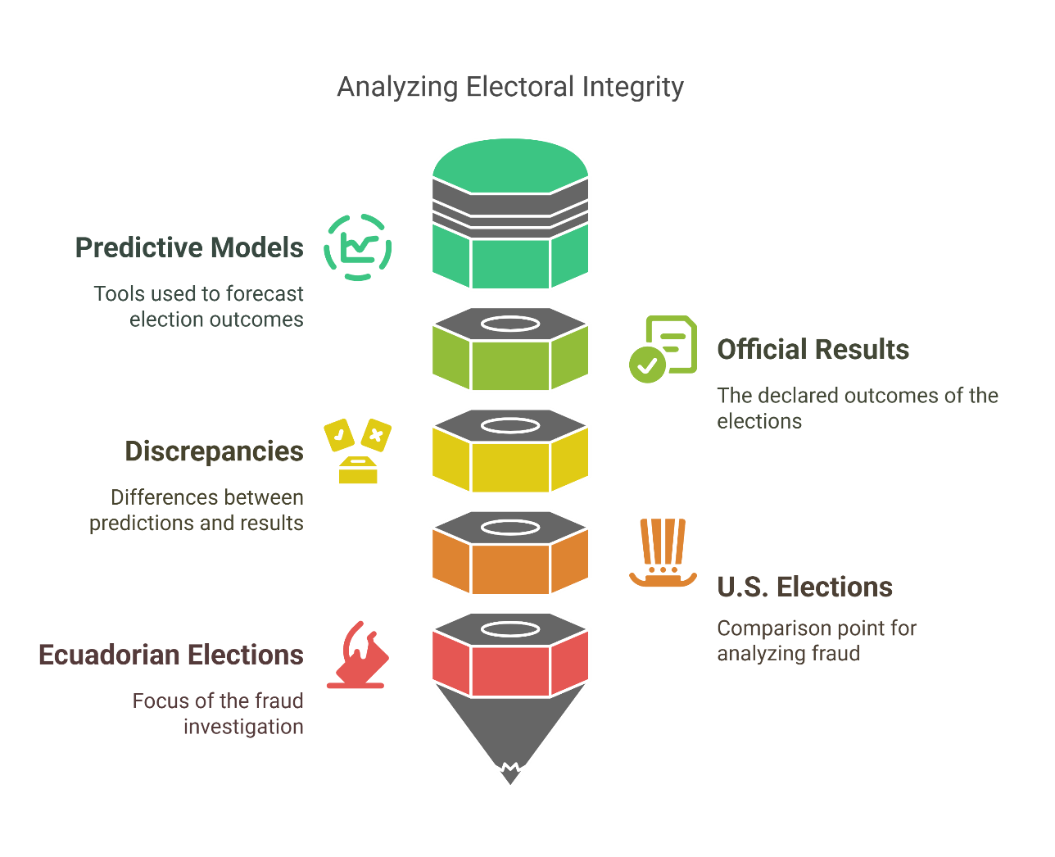
Methodology Diagram

Slide 6
Methodology
Methodology for Analyzing Electoral Fraud Hypothesis in Ecuador
1. Research Design
Objective: To analyze the hypothesis of electoral fraud in Ecuador by comparing it with the U.S. elections, focusing on social media interactions and predictive modeling.
Approach: A mixed-methods approach combining quantitative analysis of electoral data and qualitative insights from social media interactions.
2. Data Collection
Electoral Data:
Obtain official electoral results from the Ecuadorian elections and the recent U.S. elections.
Collect historical voting data, including voter turnout, demographic information, and previous election results for both countries.
Social Media Data:
Gather data from major social media platforms (Instagram, Tik Tok, Facebook, Youtube), regarding political discussions, sentiment analysis, and engagement metrics related to the elections in both countries.

Slide 7
3. Data Preprocessing
Cleaning: Remove duplicates, irrelevant posts, and spam from the social media dataset.
Normalization: Standardize data formats for both electoral and social media datasets to ensure consistency.
4. Predictive Modeling
Model Selection: We created our own model called : Campaign Winner predictor aka as Social Media Electoral Influence Model (SMEIM)
Key Features of the Model:
Input Data: The model takes social media engagement data as input, specifically the number of shares and likes for each candidate across different platforms.
Percentage Calculation: It calculates the percentage of total engagement for each candidate on each platform.
Aggregate Score: It combines these percentages into a total score (XT) for each candidate, which is then normalized to a percentage of a defined total (in this case, 400).
Output: The model outputs a predicted percentage of support for each candidate based on their social media engagement.
Feature Engineering: Identify key features from social media data that may correlate with electoral outcomes, such as:
Volume of posts and interactions
Engagement rates ( shares,likes saves)

Slide 8
Comparative Analysis
Discrepancy Identification: Compare the predicted electoral outcomes from the models with the official results from Ecuador and the U.S. elections.
Visualization: Utilize bar charts and scatter plots to visually represent the discrepancies between predicted and actual results.
Bar Charts: Display the number of votes or percentage of votes for each candidate in both countries.
Scatter Plots: Illustrate the relationship between social media engagement metrics and electoral outcomes, highlighting any outliers or irregularities.

Slide 9
6. Statistical Analysis
Hypothesis Testing: Conduct statistical tests ( chi-square tests,) to determine if the discrepancies observed are statistically significant.
Correlation Analysis: Assess the correlation between social media metrics and electoral outcomes to identify potential patterns indicative of electoral fraud.

Slide 10
7 . Interpretation of Results
Analyze the findings to draw conclusions about the integrity of the electoral process in Ecuador compared to the U.S.
Discuss the implications of social media interactions on predicting electoral outcomes and the potential for identifying irregularities.
8. Limitations and Future Research
Acknowledge the limitations of the study, such as potential biases in social media data, the influence of misinformation, and the generalizability of findings.

Slide 11
9. Conclusion
Summarize the key findings and their implications for understanding electoral integrity in Ecuador and the role of social media in political predictions and the effectiveness an millions politc will save with our model.
Tools and Software
Data Analysis: Python (Pandas, NumPy, Scikit-learn), R (dplyr, ggplot2)
Visualization: Matplotlib, Seaborn, Numpy ,Pyplot and Napkin Ai
This methodology provides a structured approach to analyzing the hypothesis of electoral fraud in Ecuador while leveraging social media interactions to enhance predictive accuracy.

Slide 12
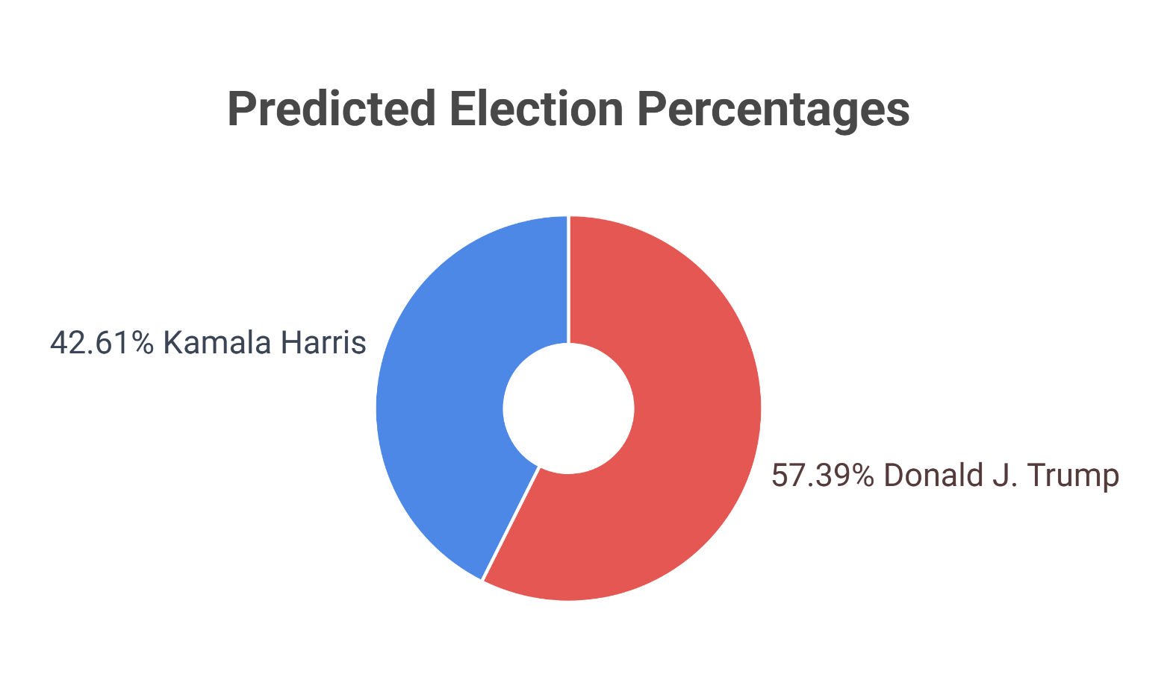
U.S. Election Results Comparison
Winner Predictor Results Candidates:
Donald J. Trump, Kamala Harris Predicted Percentages:
• Donald J. Trump: 57.39%
• Kamala Harris: 42.61%

Slide 13
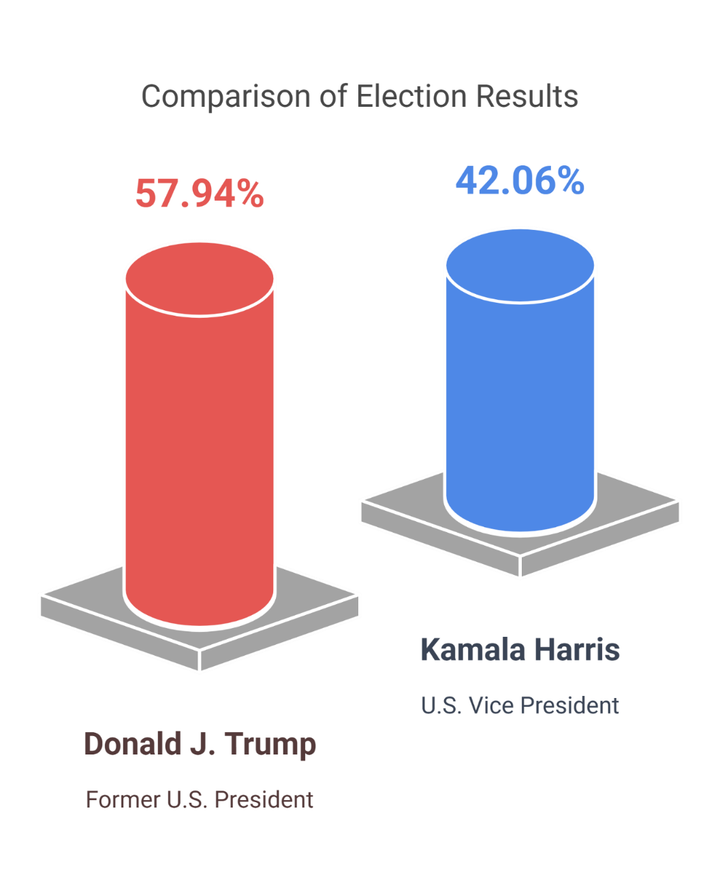
Official Results Official Percentages:
• Donald J.Trump:57.94%
• KamalaHarris:42.06%

Slide 14
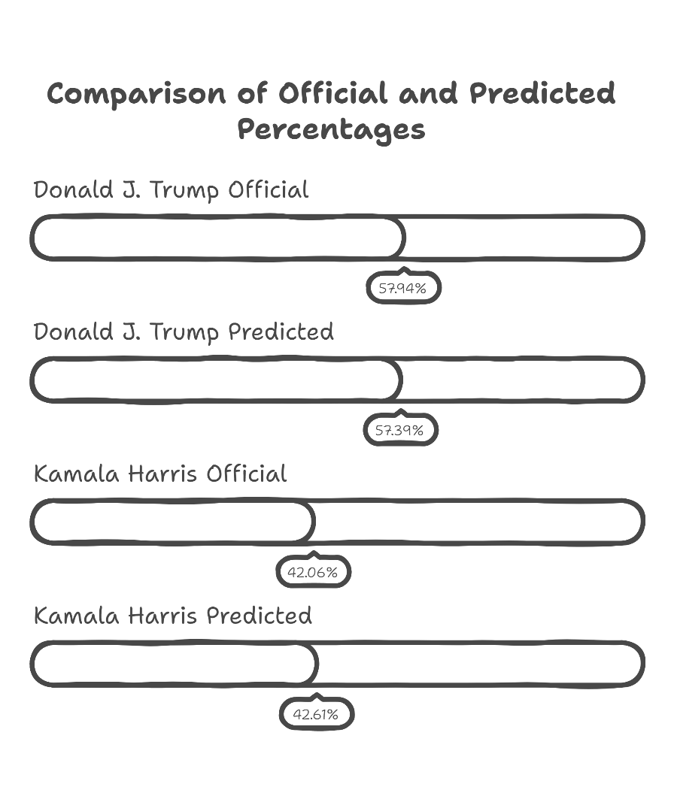

Slide 15
Predictive vs. Official Results (Insights)
Differences:
• Donald J. Trump:-0.55%
• Kamala Harris: +0.55%
Summary of Differences:
Donald J. Trump: • Official: 57.94% • Predicted: 57.39% Difference:-0.55% (Accuracy of 99.05%)
Kamala Harris: • Official: 42.06% • Predicted: 42.61% Difference: +0.55% (Accuracy of 98.70%)

Slide 16
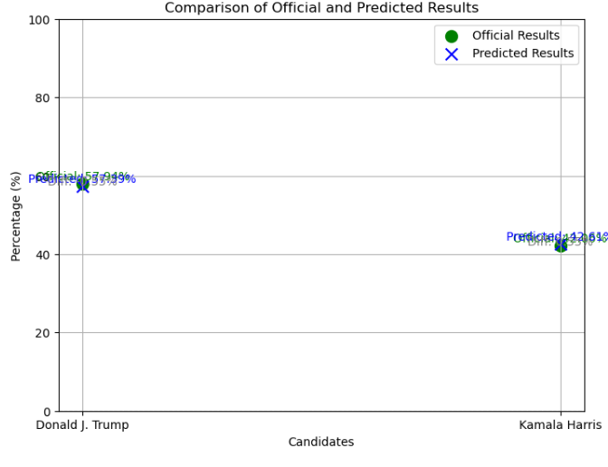
Scatter Plot USA

Slide 17
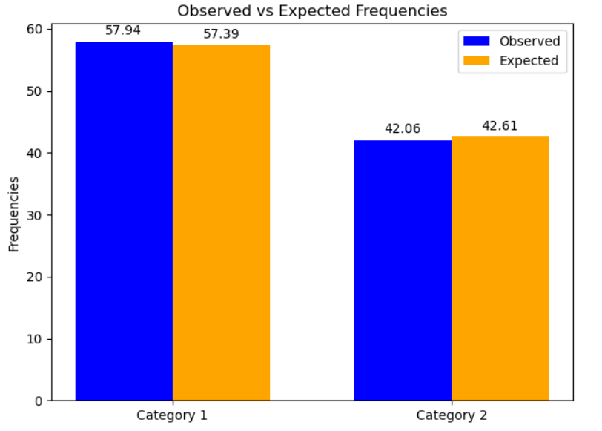
Chi Square Test USA Study

Slide 18


U.S. Election and campaign winner predictor study preliminary conclussions:
This analysis highlights the impressive accuracy of the predictive model for the U.S. elections, with a minimal deviation from the official results. Such accuracy is essential when considering the integrity of electoral systems.
Median Accuracy : 98.90%

Slide 19
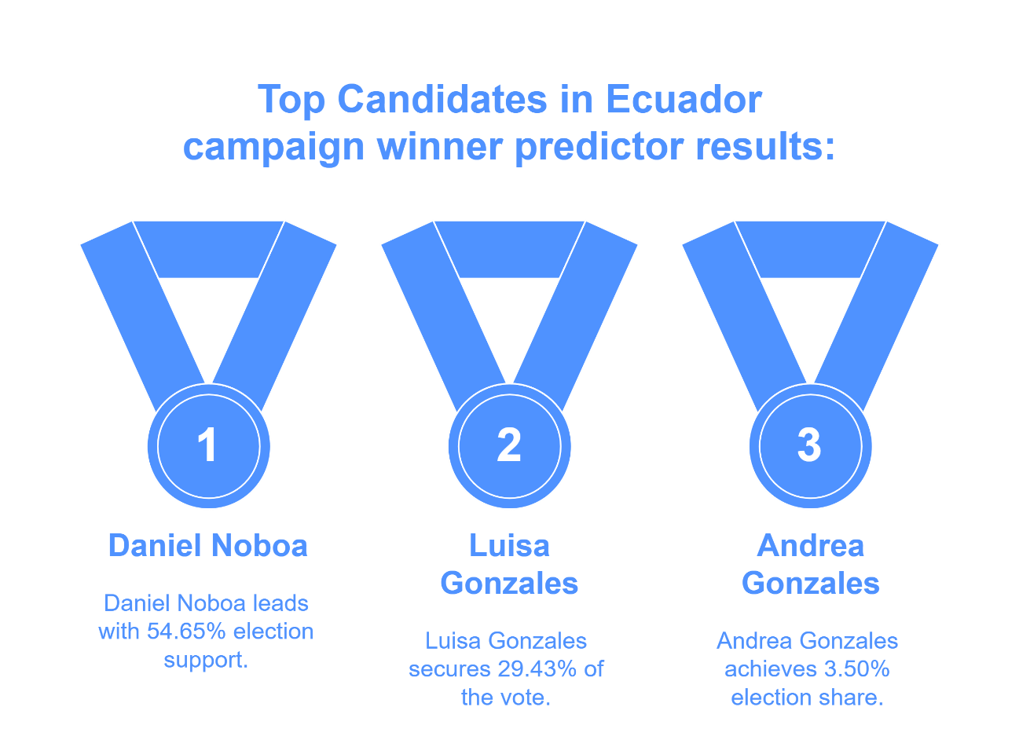
Ecuador Election Results Analysis :
Winner Predictor Results Candidates:
Daniel Noboa: 54.65%
Luisa Gonzales: 29.43%
Other candidates: < 5%

Slide 20
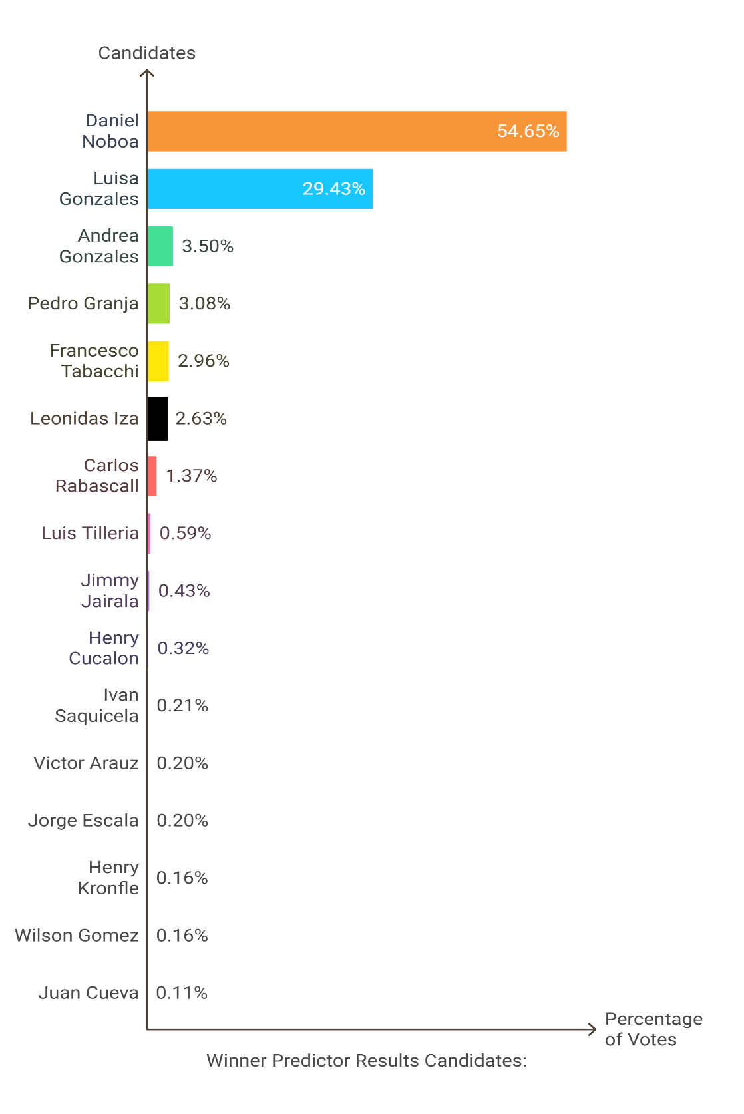

Slide 21
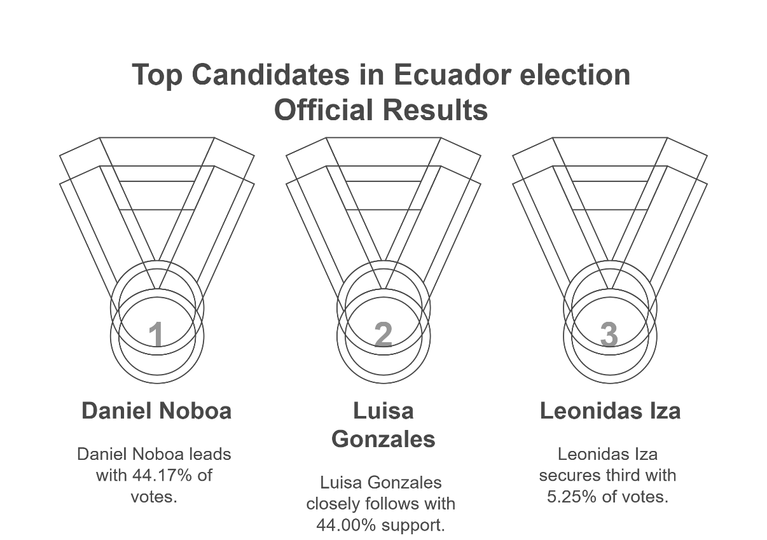
Ecuador Official Results Official Percentages:
Daniel Noboa: 44.17%
Luisa Gonzales: 44.00%
Inconsistencies According to the prior analityc predictive model

Slide 22
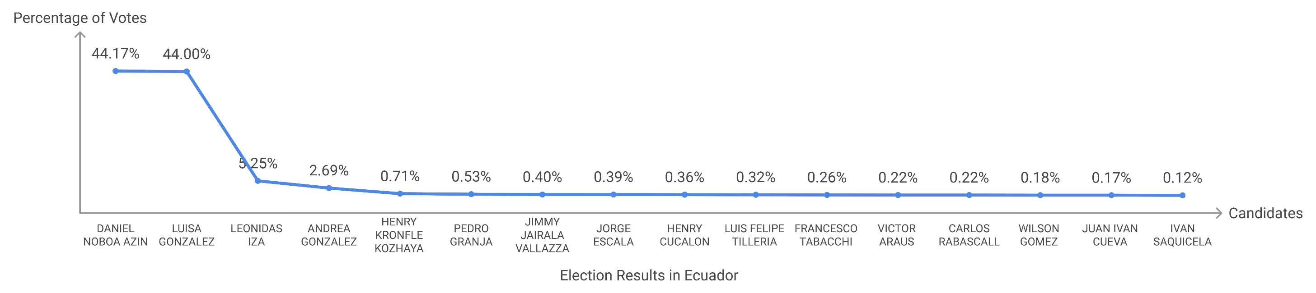
Official Results

Slide 23
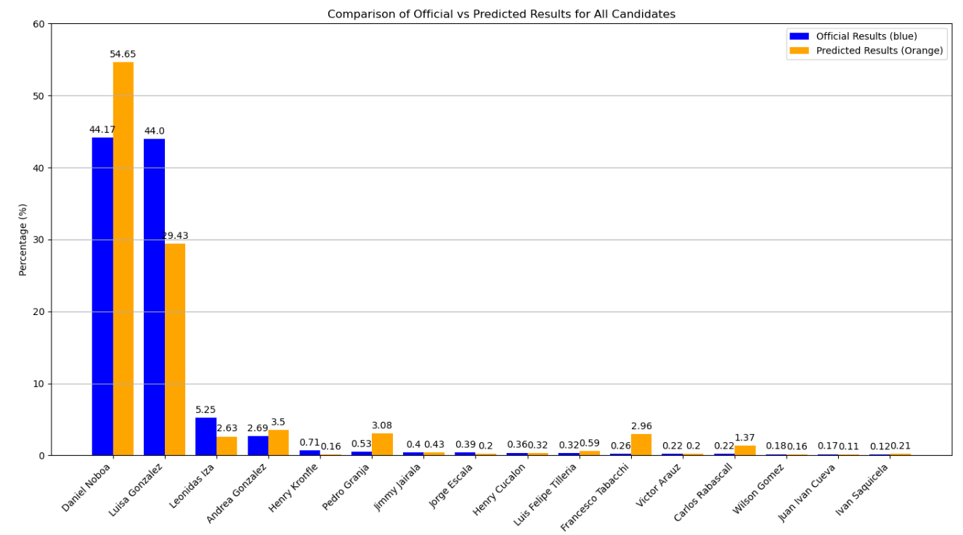
Comparison of Official vs Predicted Results for All Candidates Ecuador

Slide 24
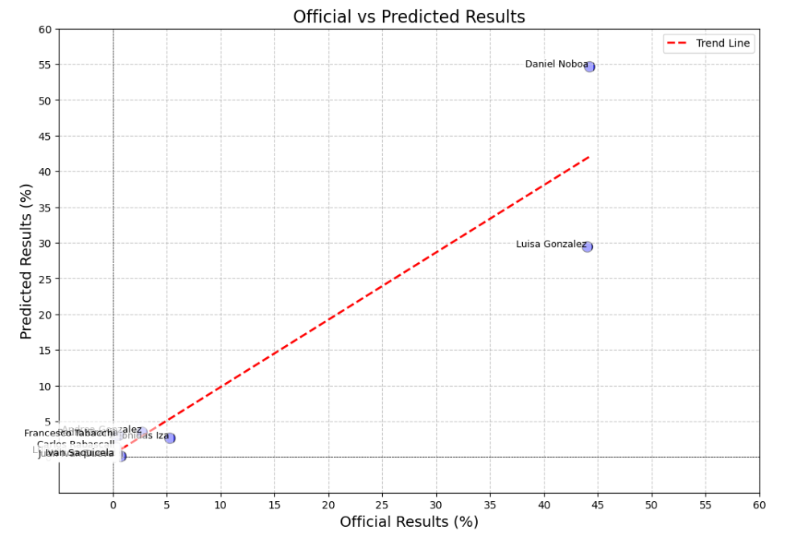
Scatter Plot Ecuador

Slide 25
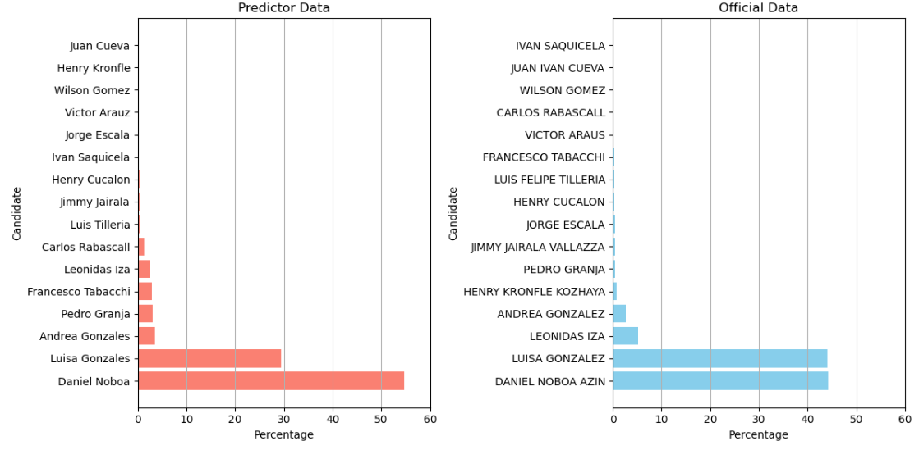
Chi Square test Ecuador

Slide 26
Ecuador Election and campaign winner predictor study preliminary conclusions:
The predictive model for the Ecuadorian election shows a notable deviation from the official results, particularly for Daniel Noboa.
Found accuracy of approximately 68.75%. The overall analysis suggests that the predictive model was less reliable in Ecuador compared to the U.S. elections. Further investigation into the discrepancies is warranted.

Slide 27
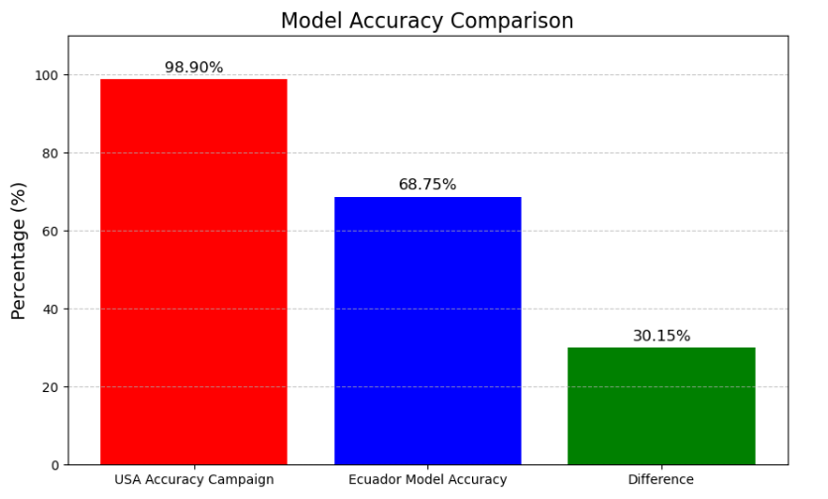
Models Accuracy Comparison between USA and Ecuador

Slide 28
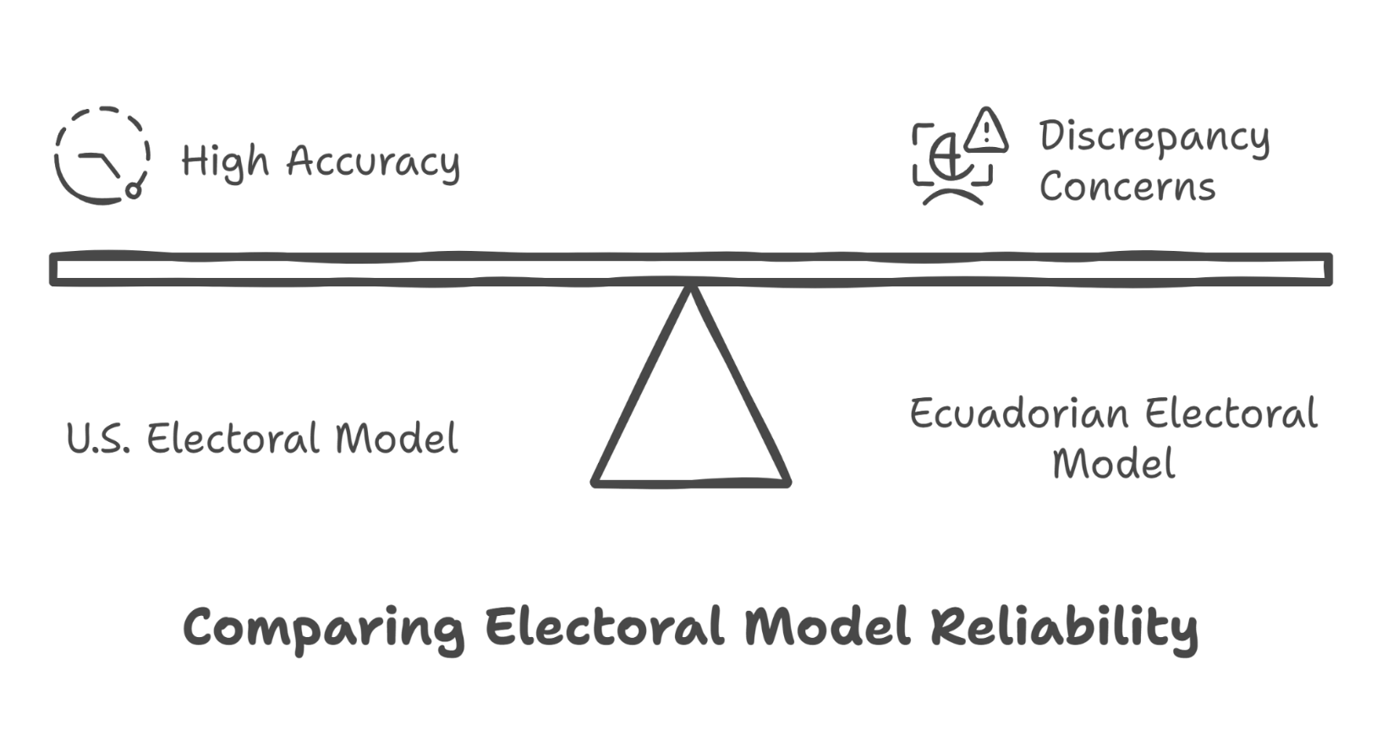
Conclusion:
The analysis of predictive models and official results from both the U.S. and Ecuador elections reveals notable discrepancies, specially when the same algorythim was used in both countries. The impressive accuracy of the U.S. predictive model, with a deviation of only -0.55% for Trump and +0.55% for Harris, underscores the reliability of the electoral process in the U.S. In contrast, the significant differences in Ecuador's results raise questions about the integrity of the electoral process there Further investigation is warranted to substantiate claims of potential fraud. While other companies expends millions in poles enquires our model have created a precise and diligent way to forecast electoral outcomes saving future aspiring politicians and political marketing strategies millions .

Slide 29
Additional Codes / Algorythms, Model Equation and XMLS
Campaign Winner predictor Python Codes and Graphs
Campaign Winner Predictor equation and algorythm
Xml :
USA Campaign Winner predictions
USA Official results
Ecuador Campaign Winner Prdictions
Ecuador Official results
USA and Ecuador Final Percentage Wrap Up

